Slide 1
PCA (Unsupervised Learning)
Dr. Deepak Mehta

Slide 2
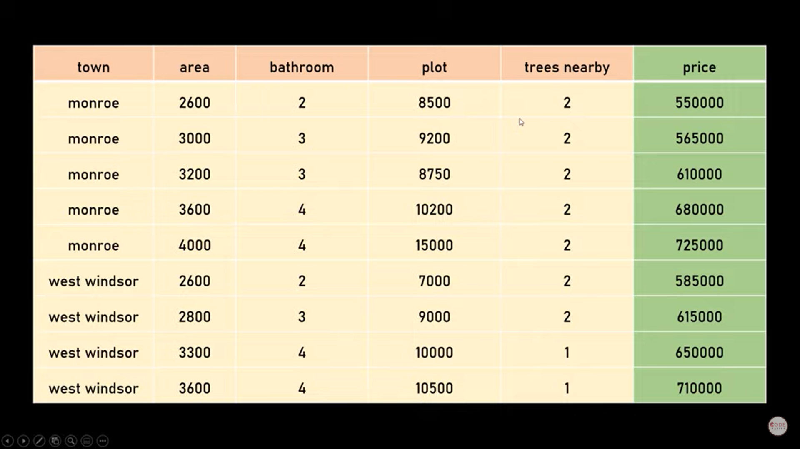

Slide 3
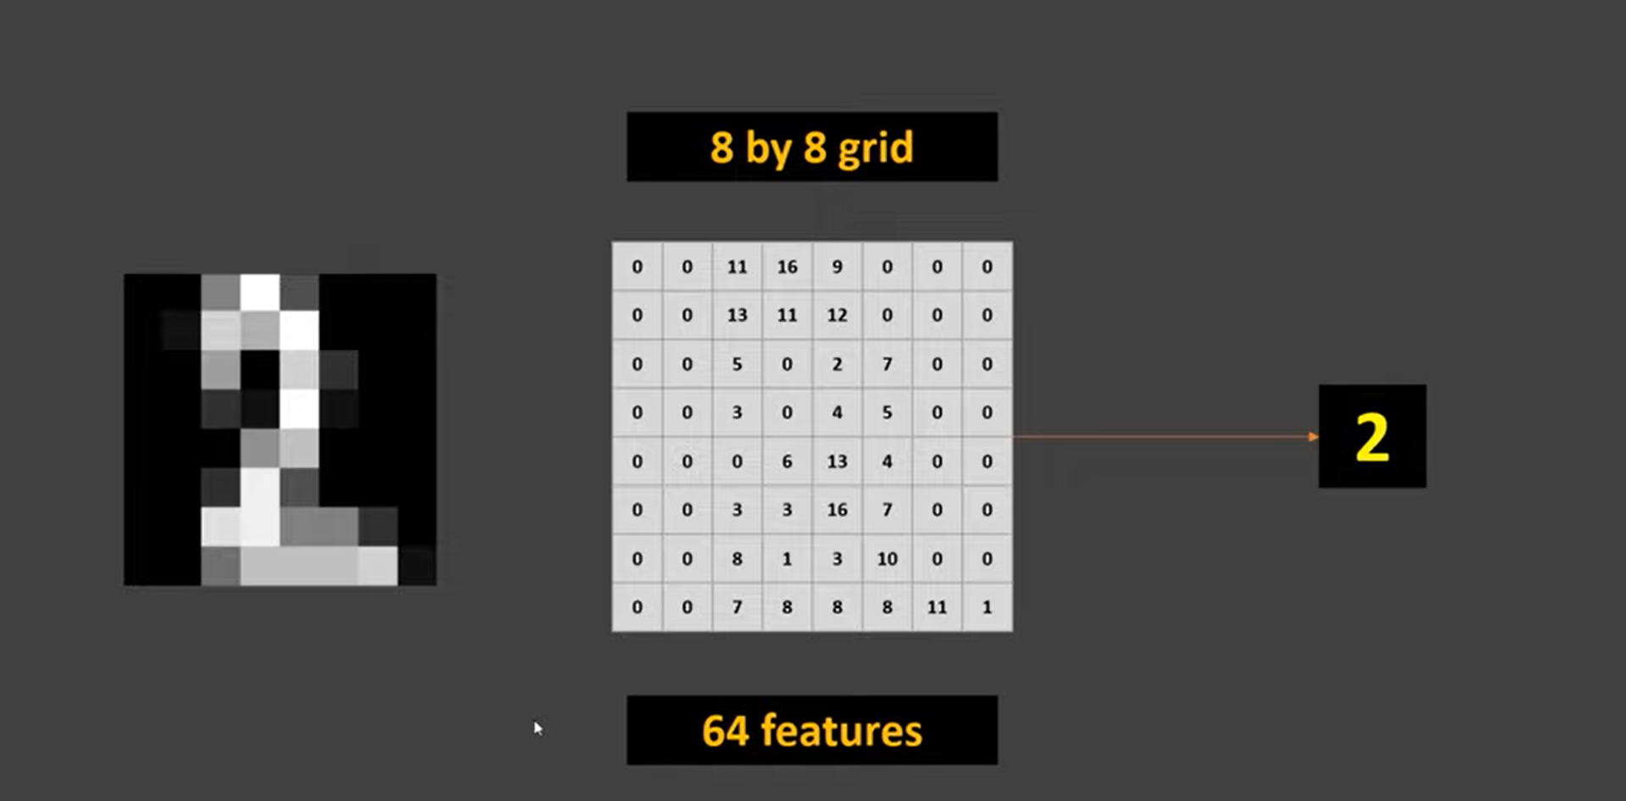

Slide 4


Slide 5
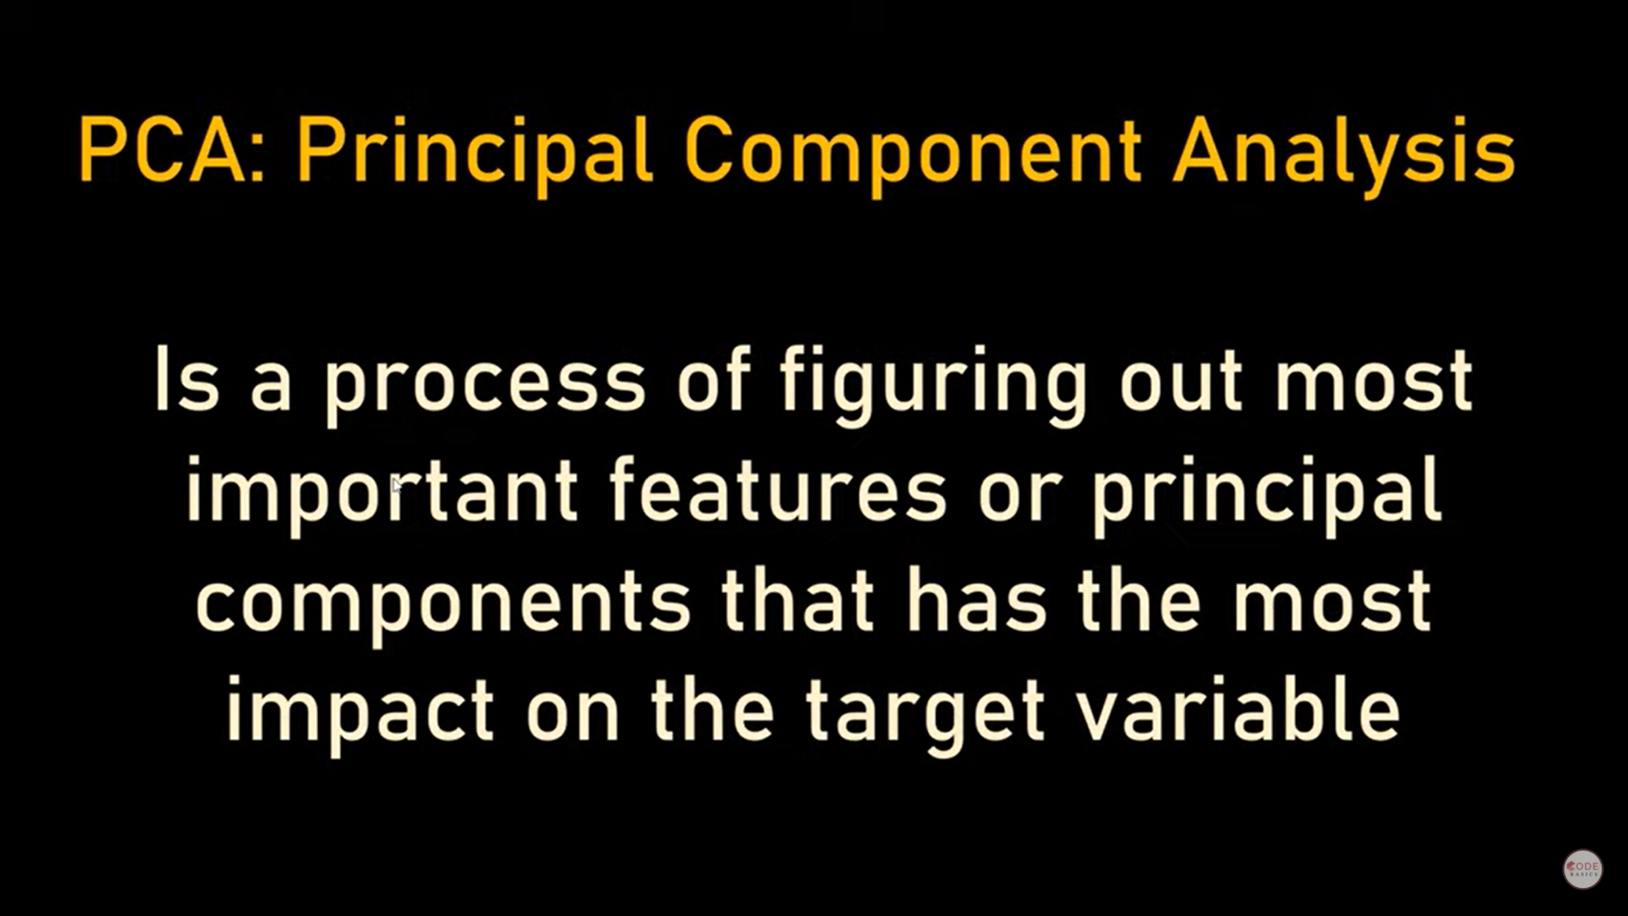

Slide 6
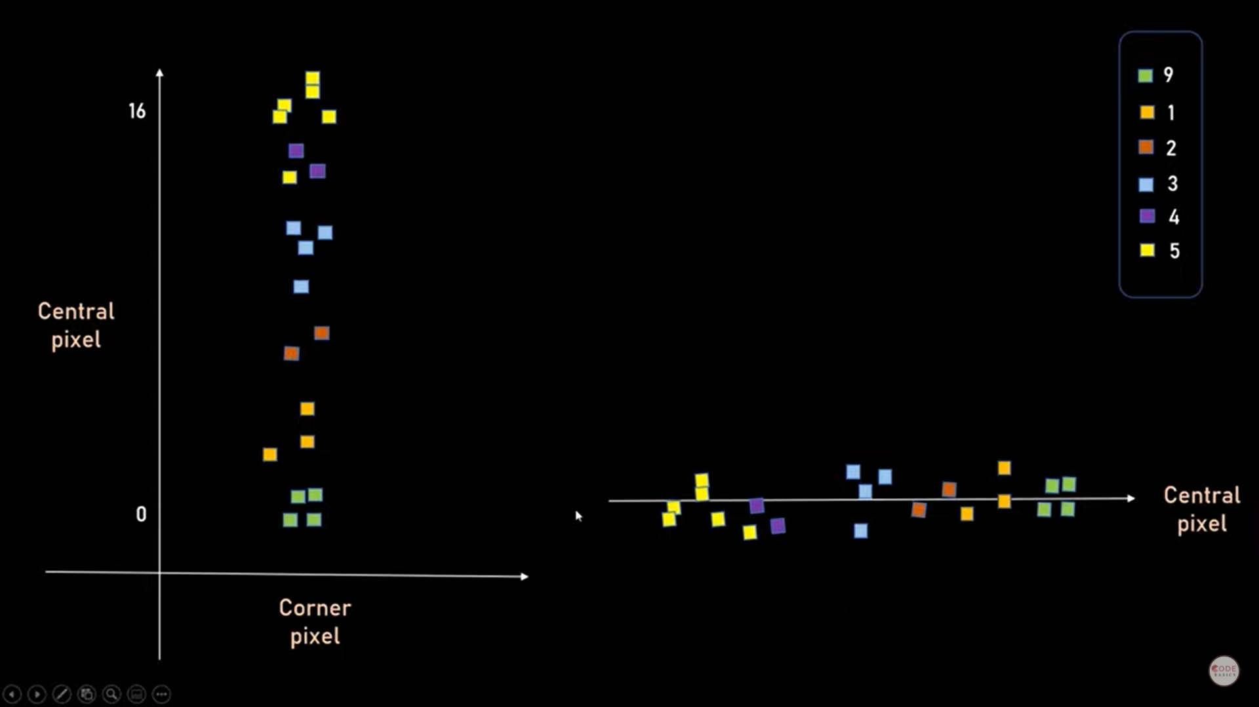

Slide 7
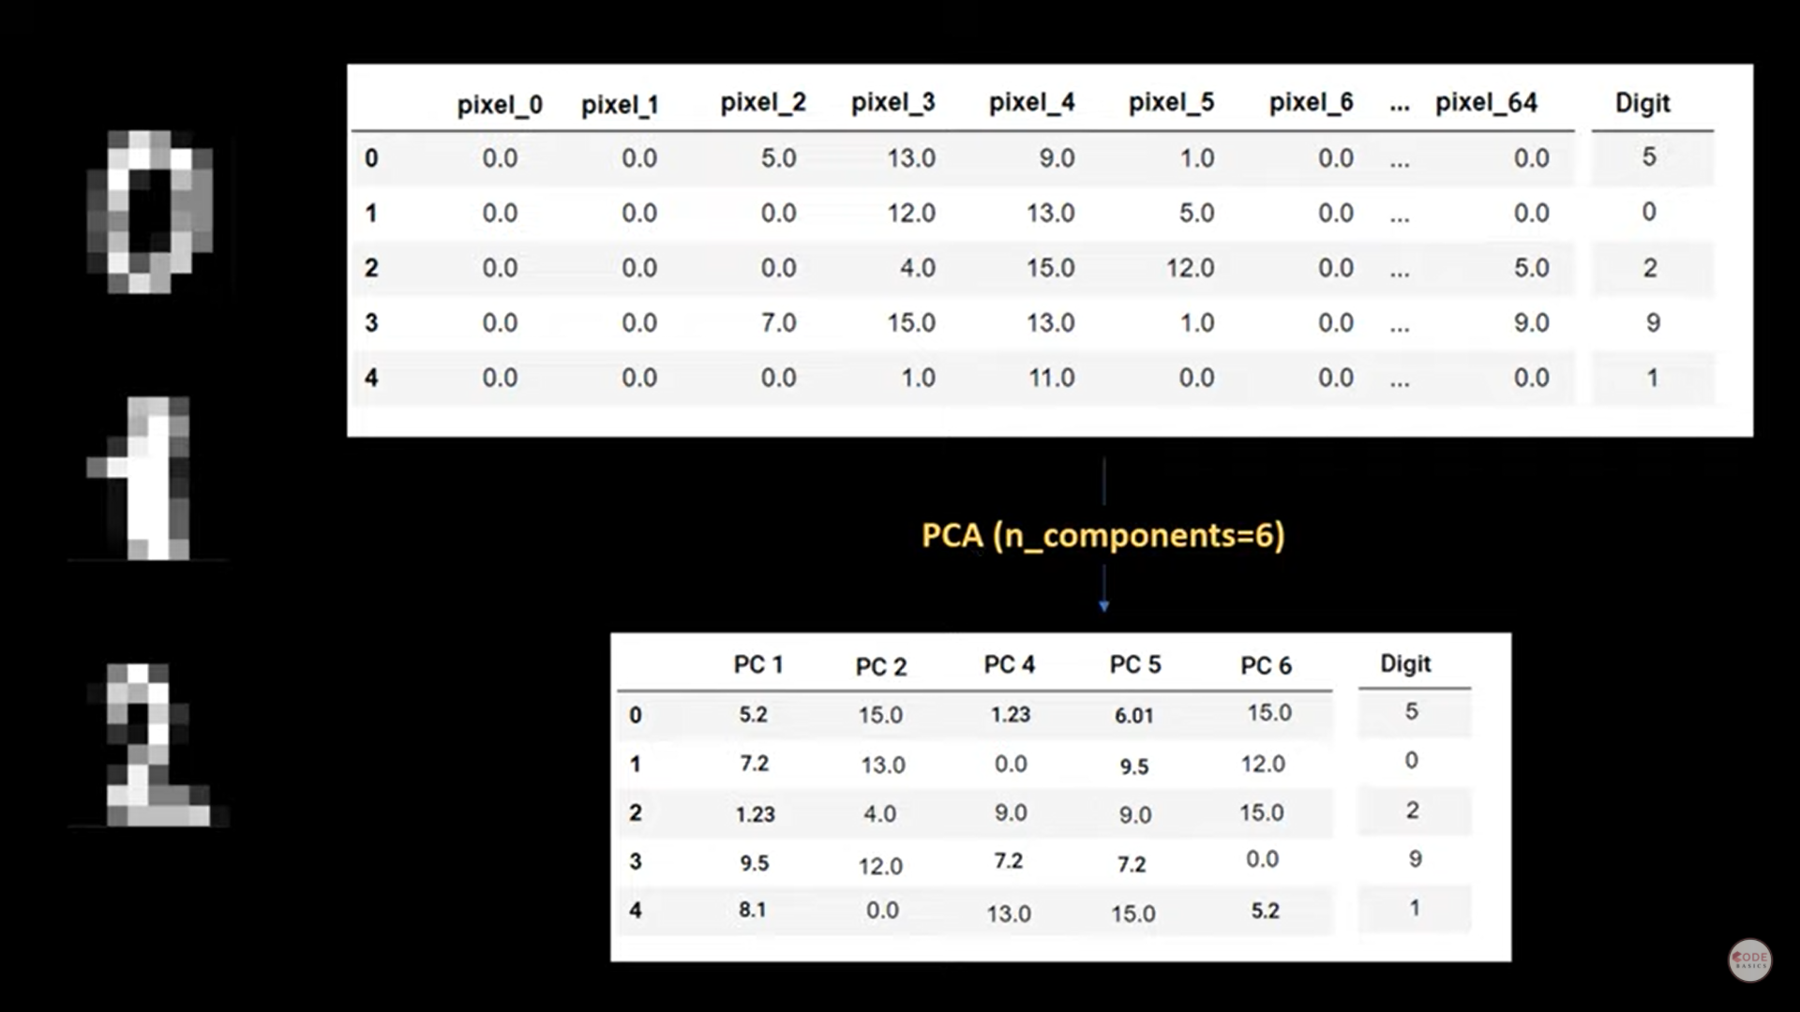

Slide 8
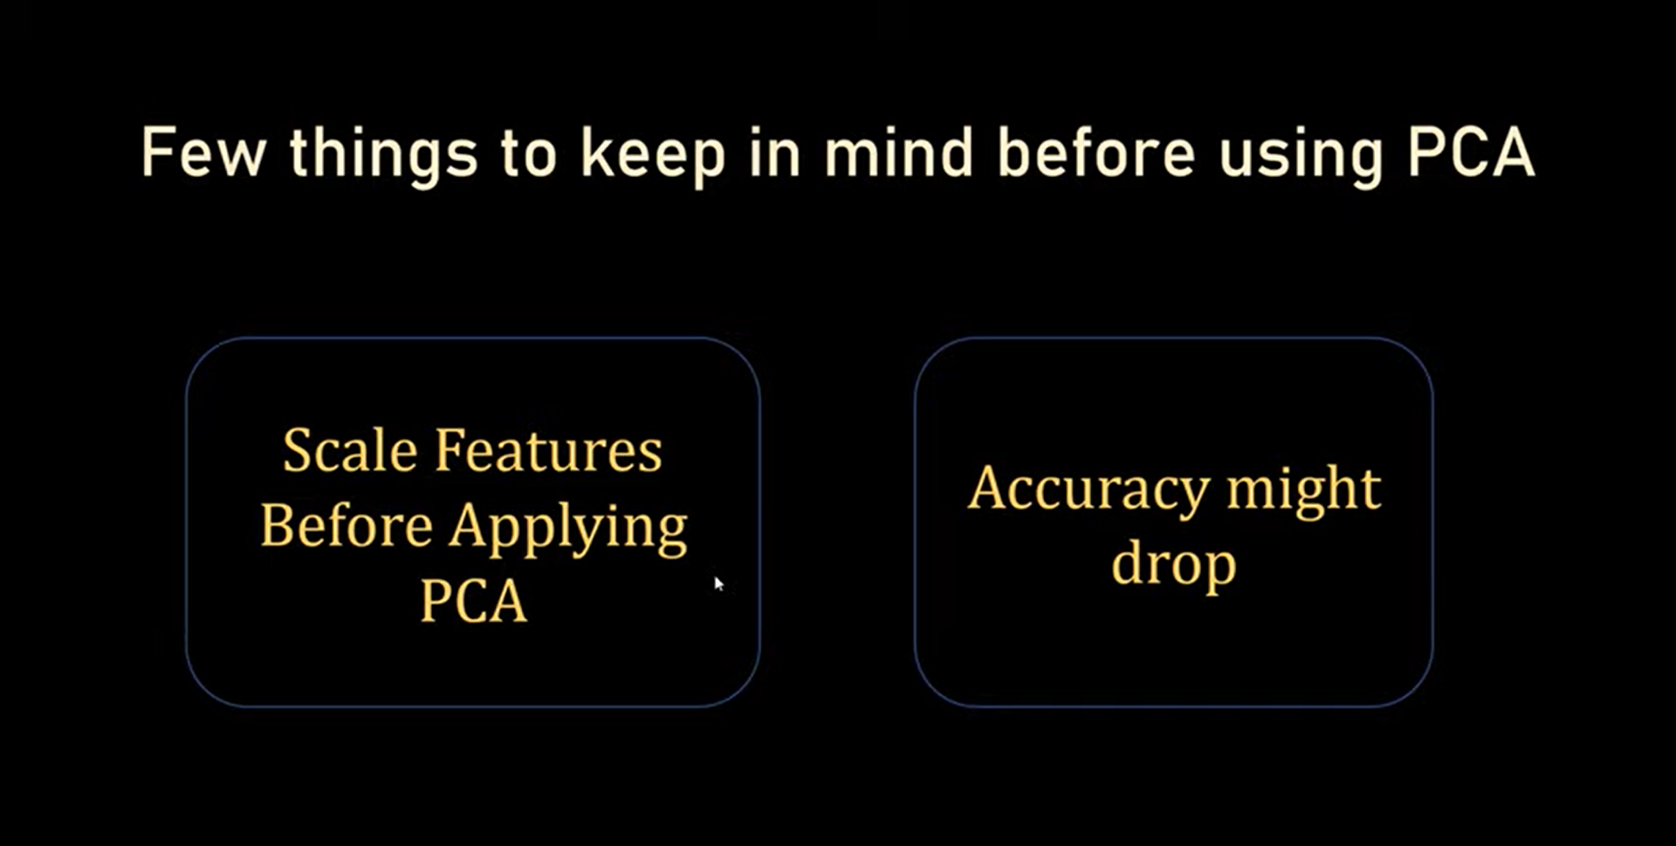

Slide 9
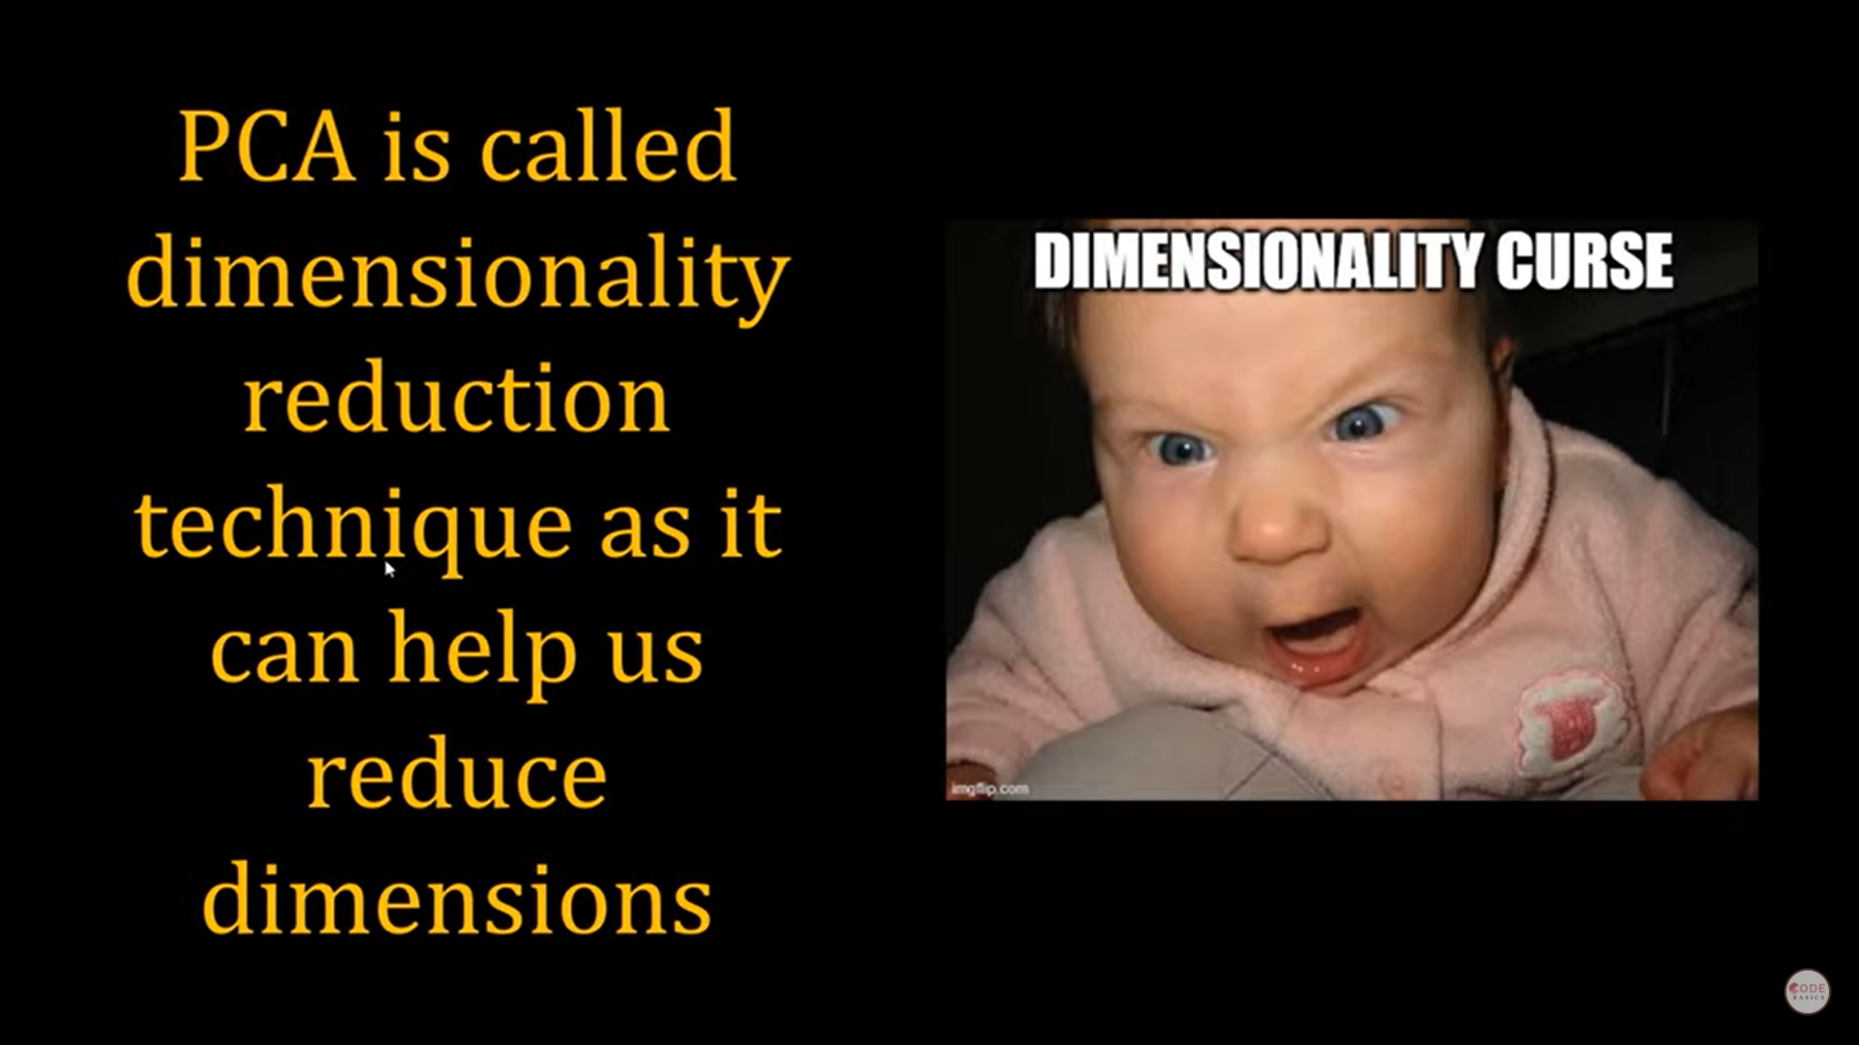

Slide 10
Principal Component Analysis
PCA is used to find out the dimensions(also known as components) with maximum variance(where the data is spread out).
Features with little variance in the data are then projected into new lower dimension.
Def. Principal component analysis (PCA) is a technique for reducing the dimensionality of such datasets, increasing interpretability but at the same time minimizing information loss. It does so by creating new uncorrelated variables that successively maximize variance. Finding such new variables, the principal components, reduces to solving an eigenvalue/eigenvector problem.

Slide 11
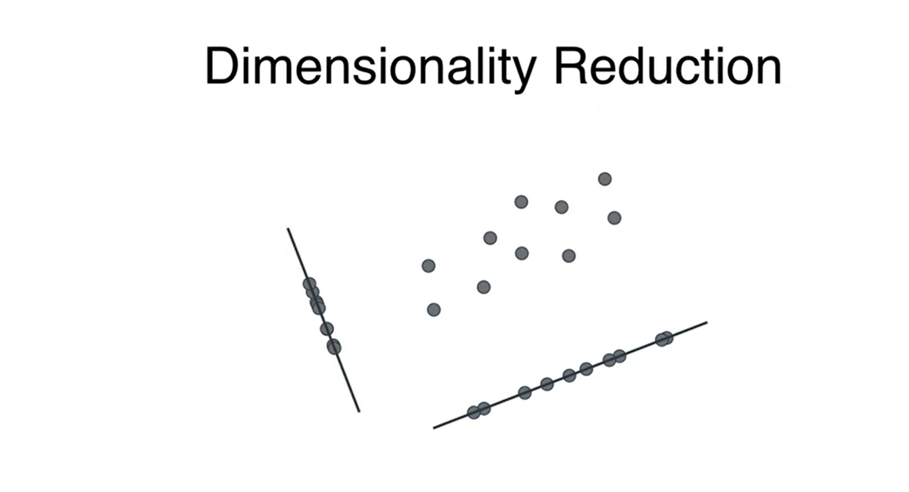

Slide 12
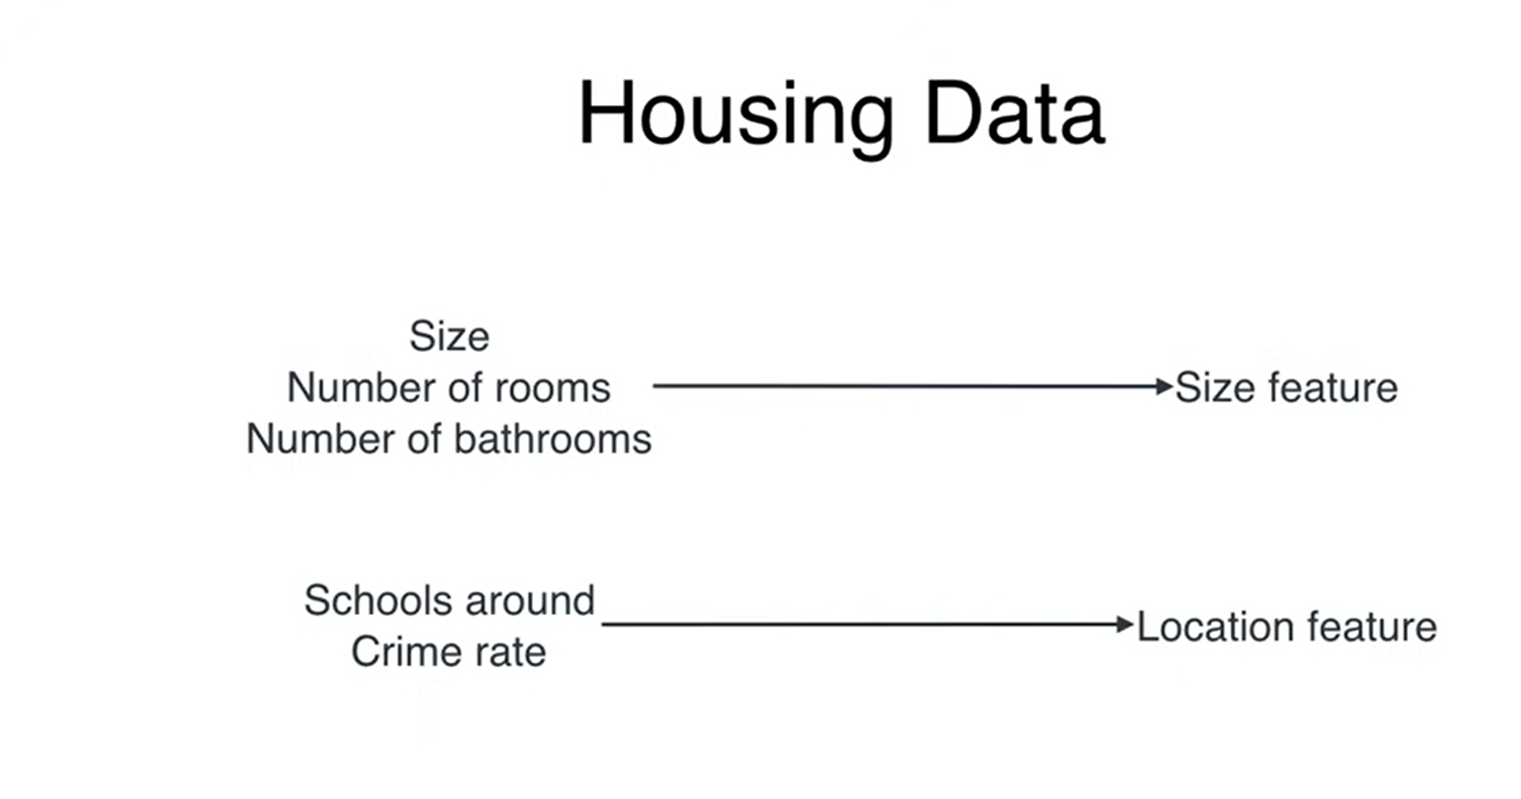

Slide 13
Principal Component Analysis
PCA is a feature reduction technique
In a dataset, there can be many features like f1,f2,f3….fn
Some features from entire dataset may or may not be important or some of them can be
For 100 features, the Principal component give 100 pc
From 100 pc , I will select top n feature basis on variance explained
PC1, PC2, PC3,…
80%, 15%, 3%,...

Slide 14
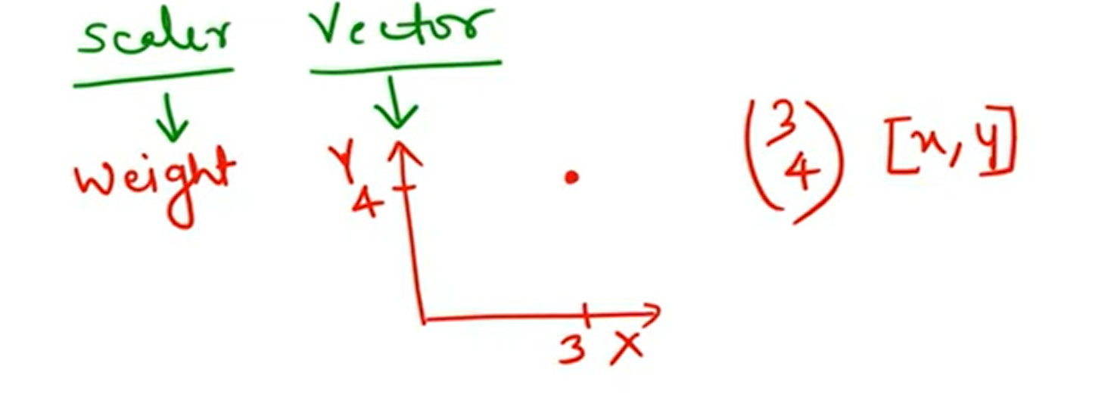
Scaler, Vector
Anything where we see magnitude, it is a scaler quantity like weight of a person
Anything where we see magnitude and direction, it is vector quantity like position of aircraft

Slide 16

Eigen Vector and Eigen Value from given Matrix

Slide 17
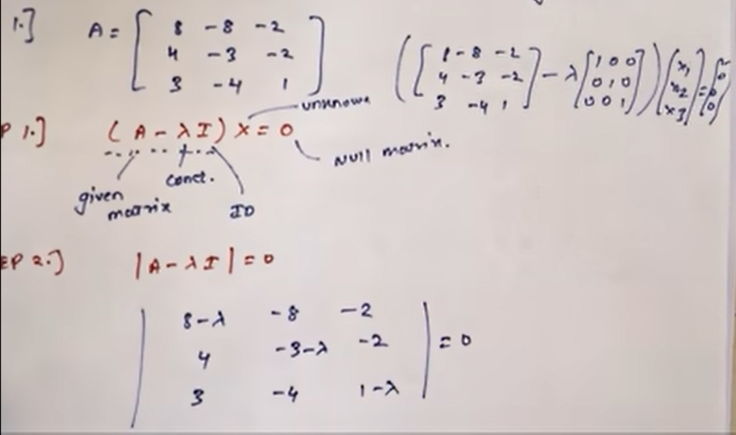
..

Slide 18
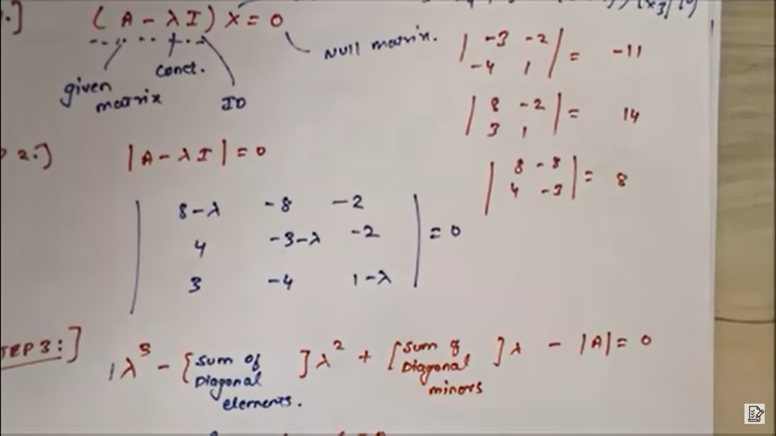

Slide 19
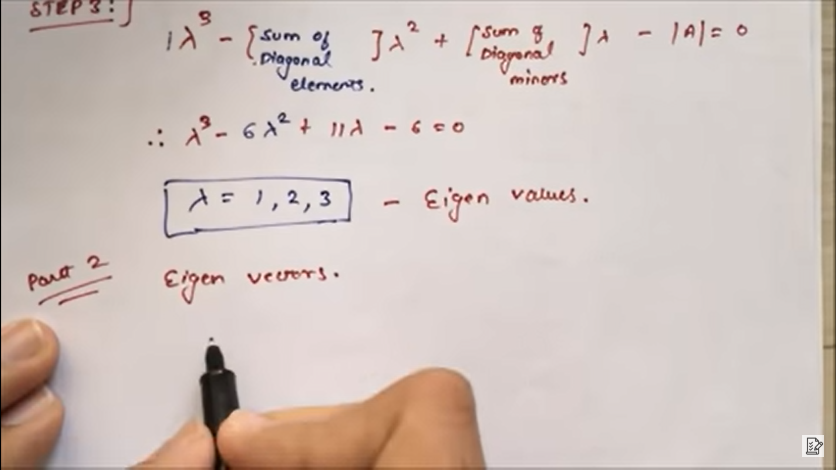
Eigen values

Slide 20
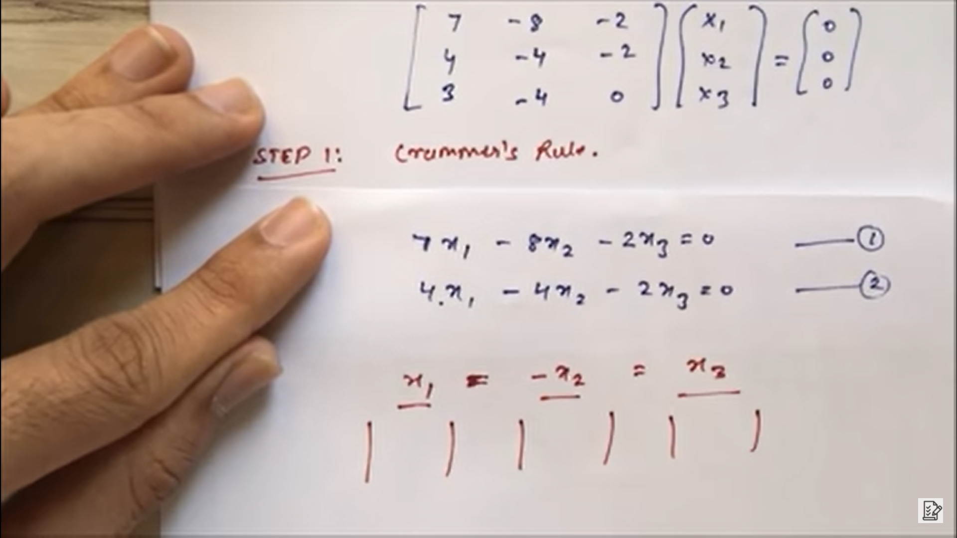
Eigen Vectors calculations

Slide 21

..continued

Slide 22

Finally..

Slide 23
Terminologies
Convert the given matrix into eigen vector
Our matrix mXn → eigen vector , converting into lower dimension
We will get Eigen value as magnitude of vector

Slide 24
Steps to calculate PCA
Step 1: Standardize the dataset.
Step 2: Calculate the covariance matrix for the features in the dataset.
Step 3: Calculate the eigenvalues and eigenvectors for the covariance matrix.
Step 4: Sort eigenvalues and their corresponding eigenvectors.
Step 5: Pick k eigenvalues and form a matrix of eigenvectors.
Step 6: Transform the original matrix.

Slide 25
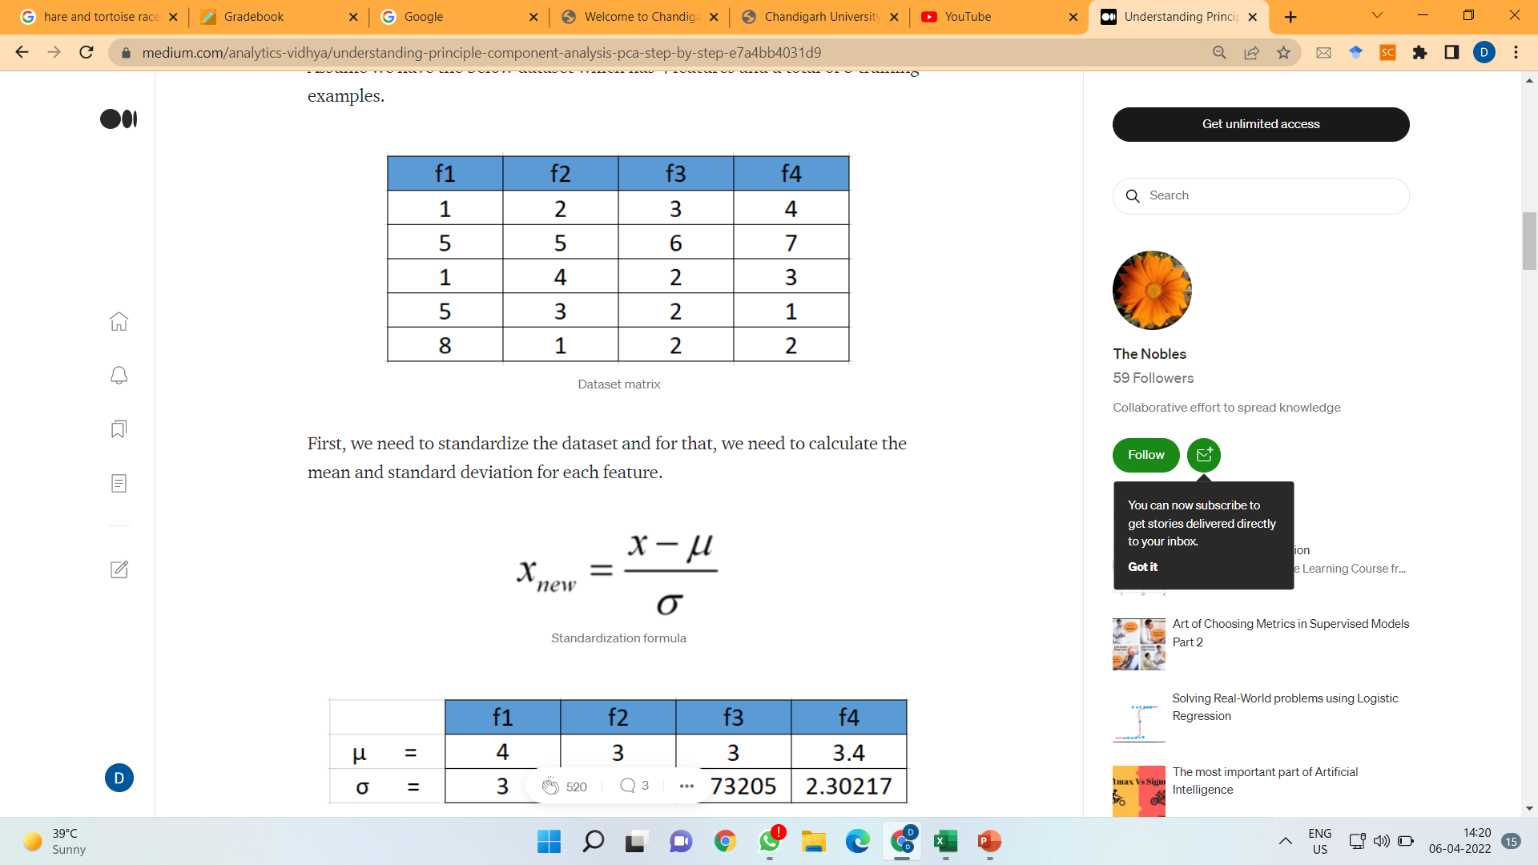
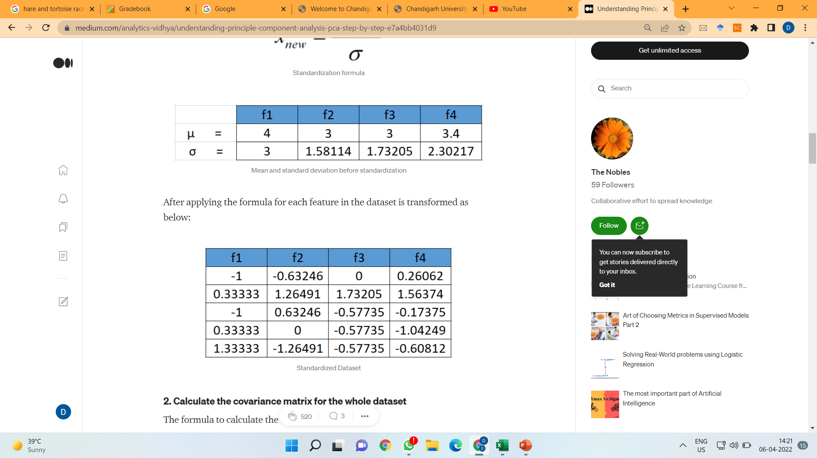
Standardize the Dataset

Slide 26
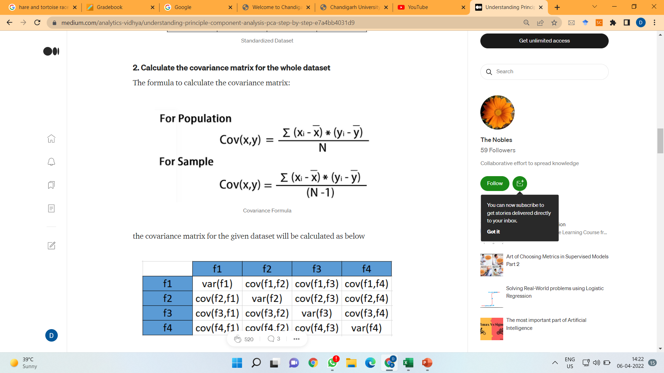
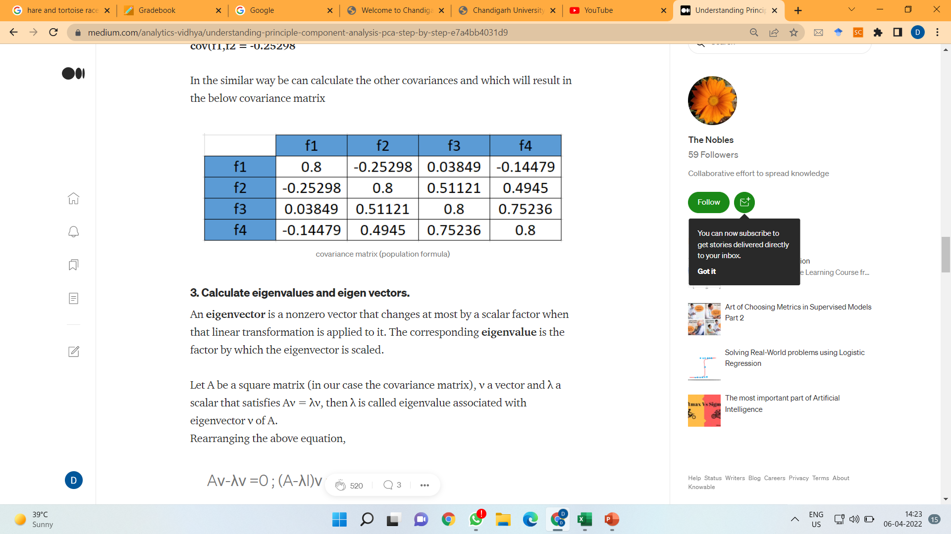
Calculate the covariance matrix for the whole dataset

Slide 27
Calculate eigenvalues and eigen vectors
An eigenvector is a nonzero vector that changes at most by a scalar factor when that linear transformation is applied to it.
The corresponding eigenvalue is the factor by which the eigenvector is scaled.

Slide 28
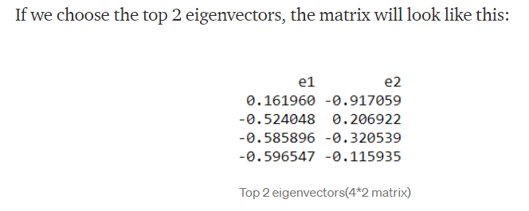
Pick k eigenvalues and form a matrix of eigenvectors

Slide 29
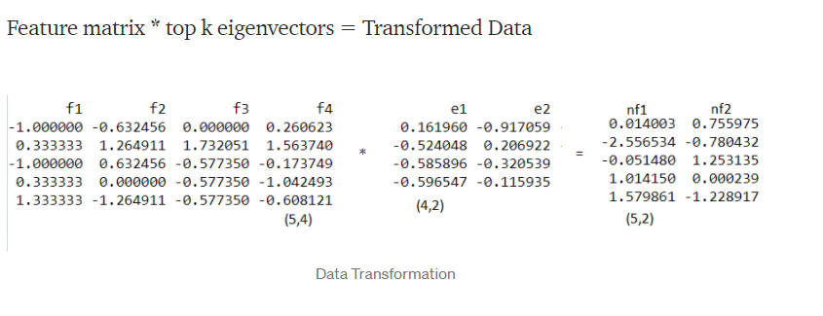
Transform the original matrix

Slide 30
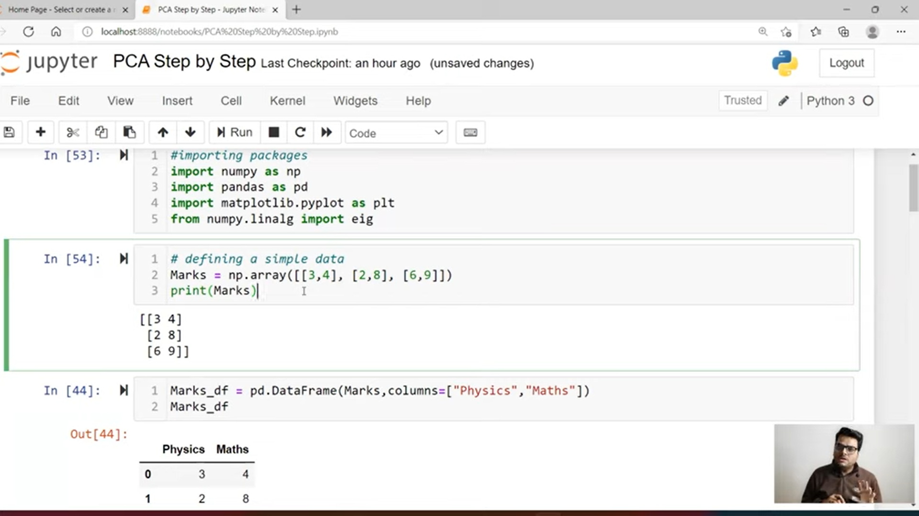

Slide 31
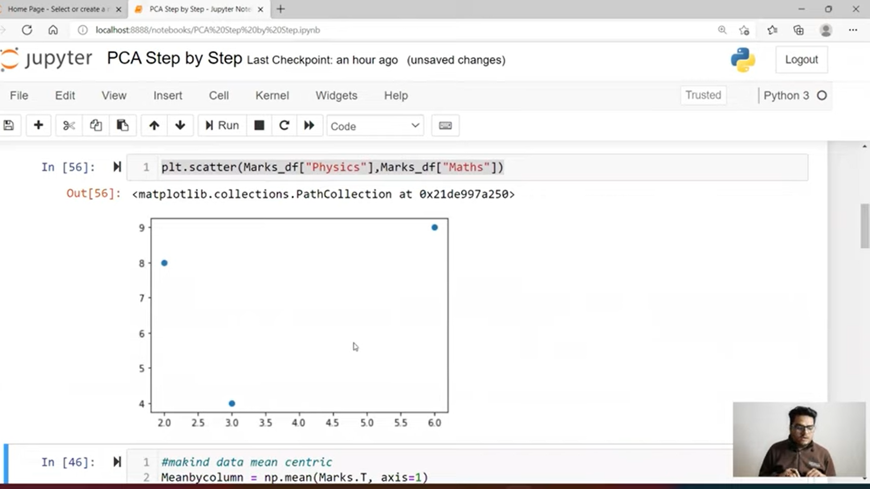
Visualize Scatternets of data

Slide 32
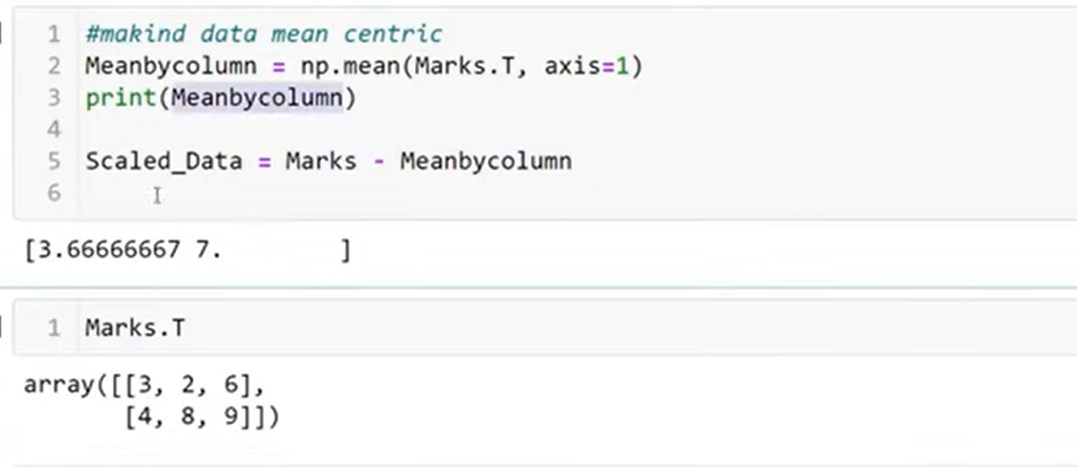
Scaling

Slide 33
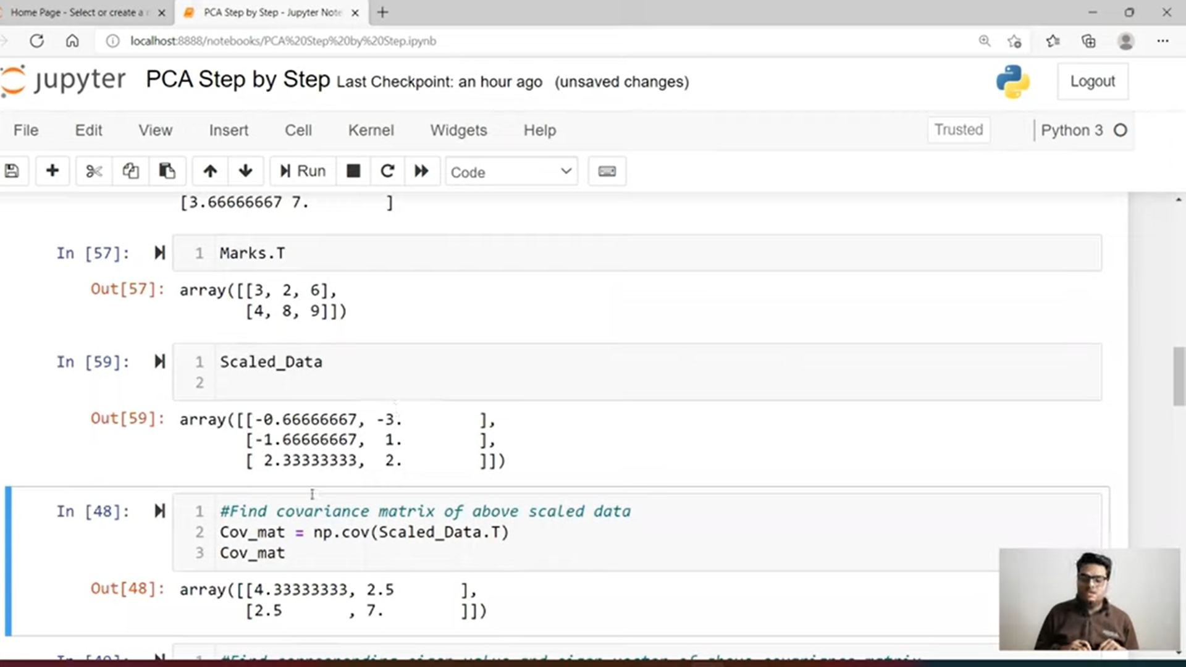
Covariance Matrix

Slide 34
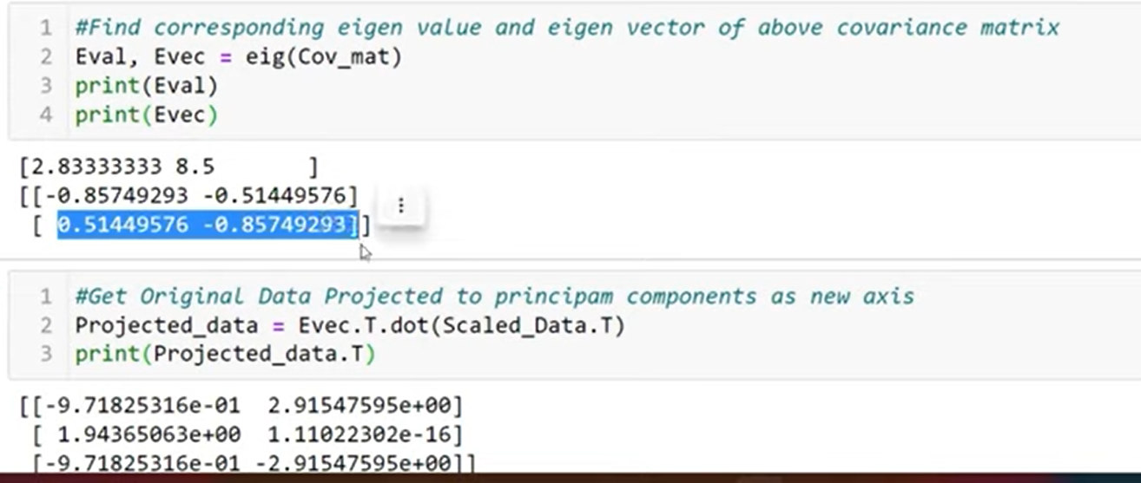
Calculate eigen and vector in python

Slide 35
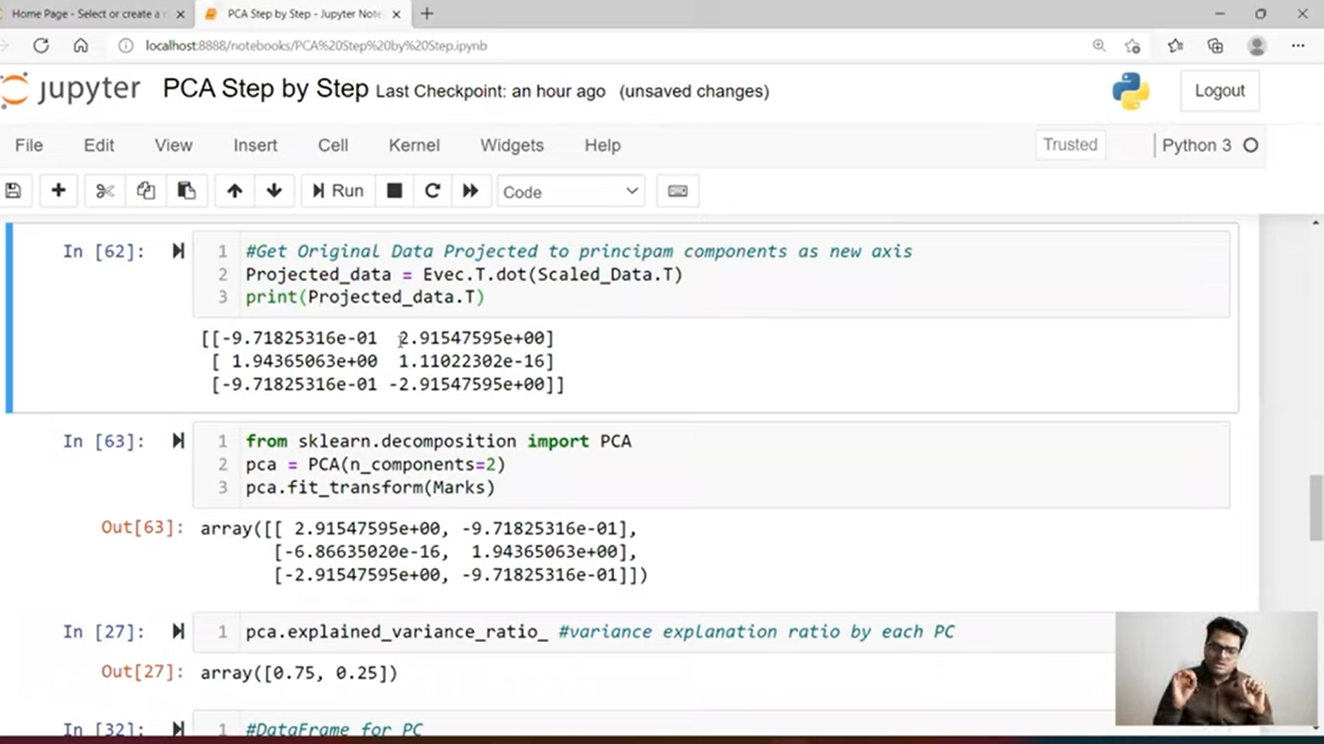
Manual steps O/P vs Sklearn O/P

Slide 36
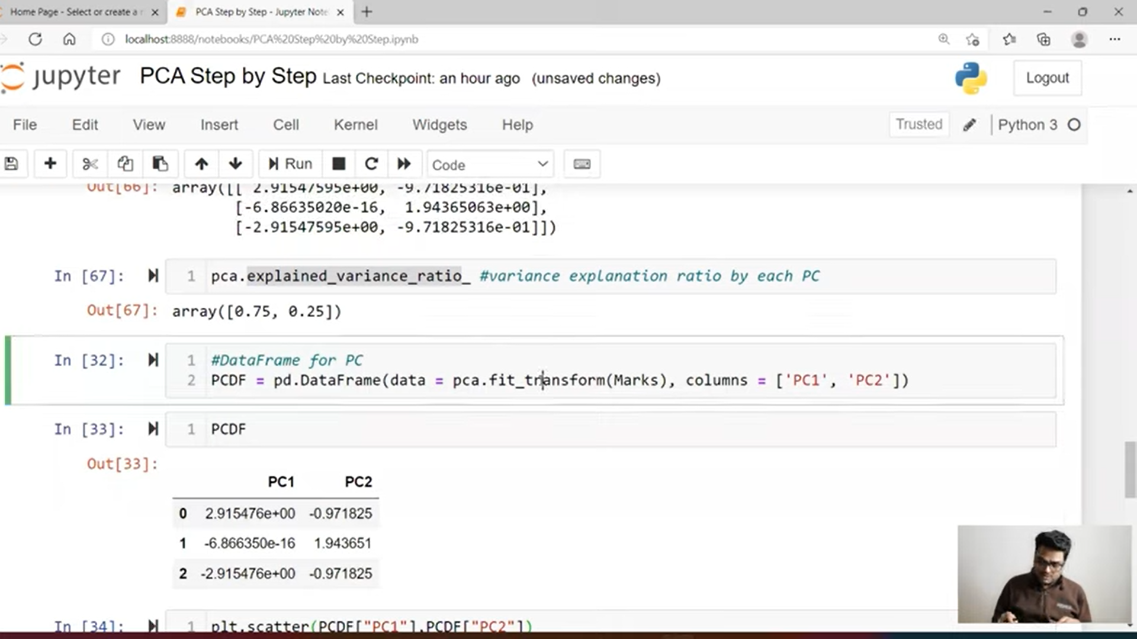
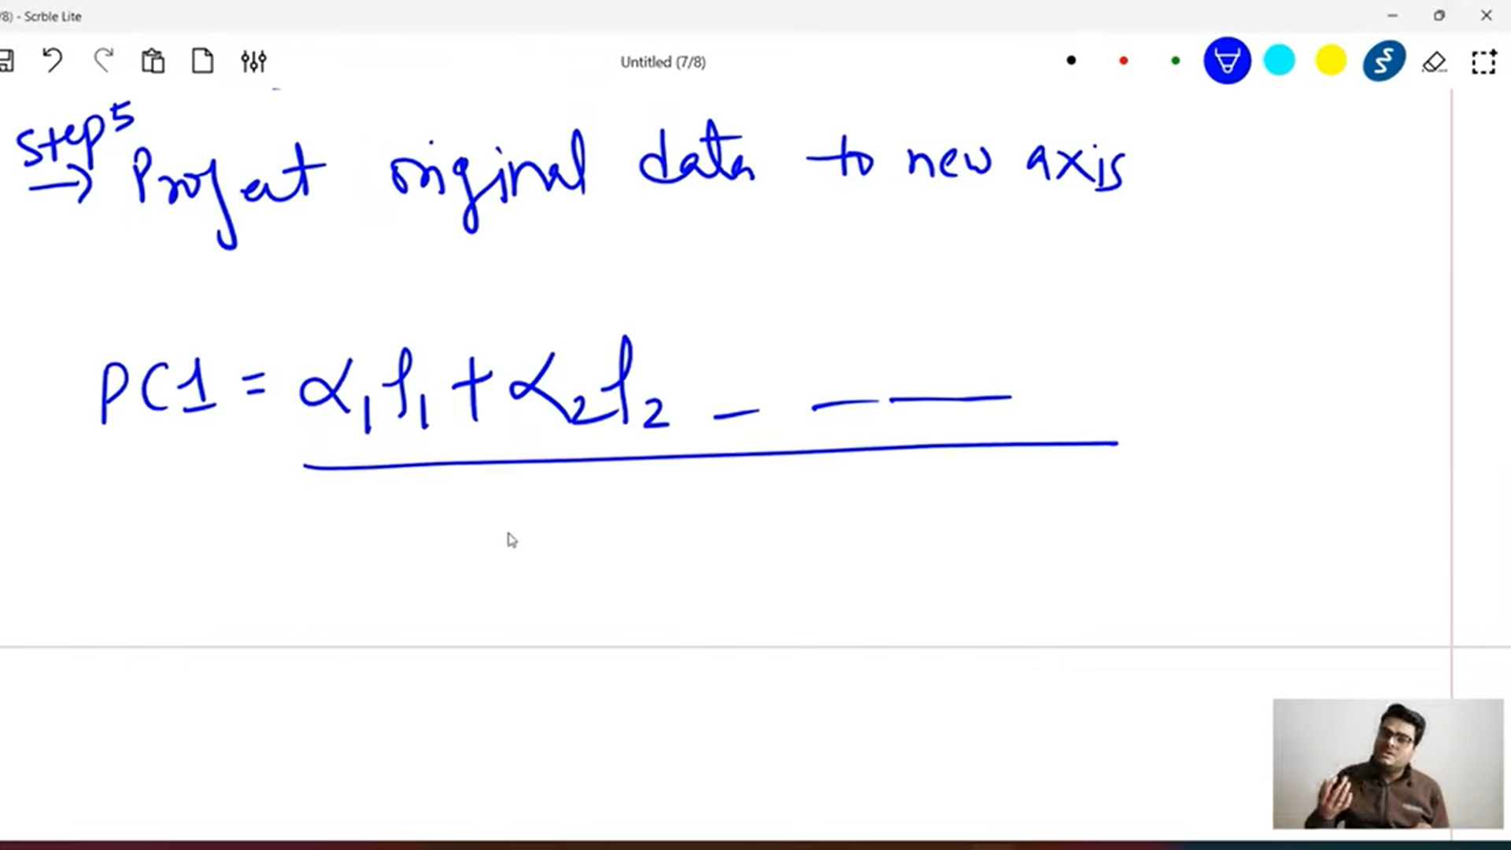
PC1 and PC2

Slide 37
loadings

Slide 38
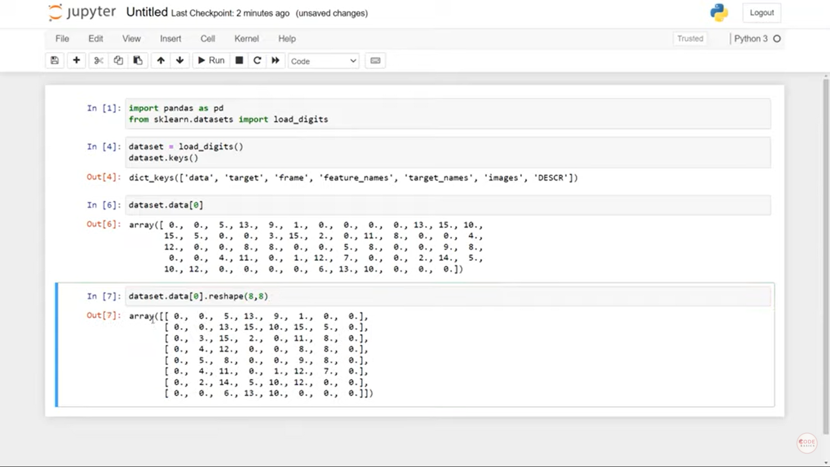

Slide 39
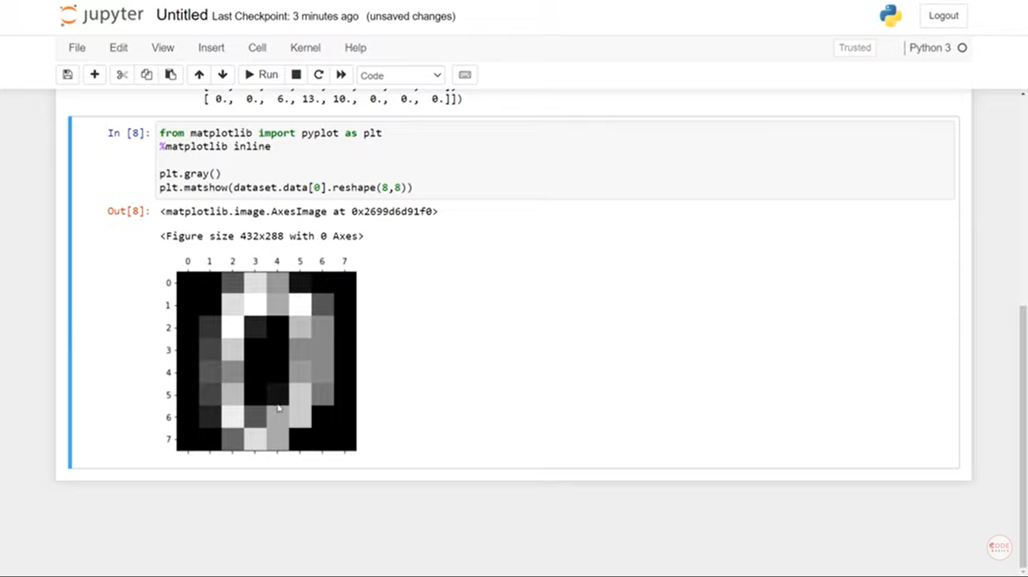

Slide 40
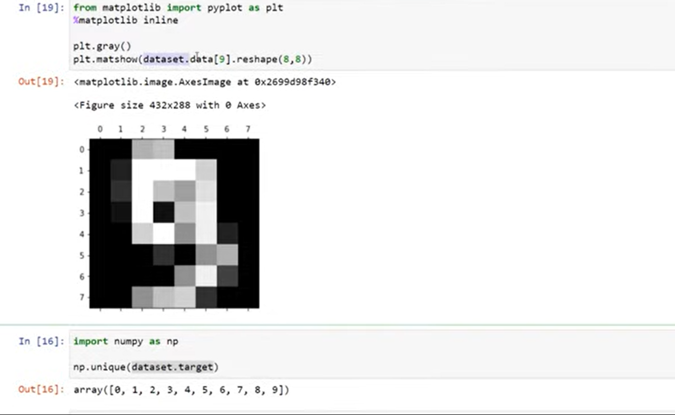

Slide 41
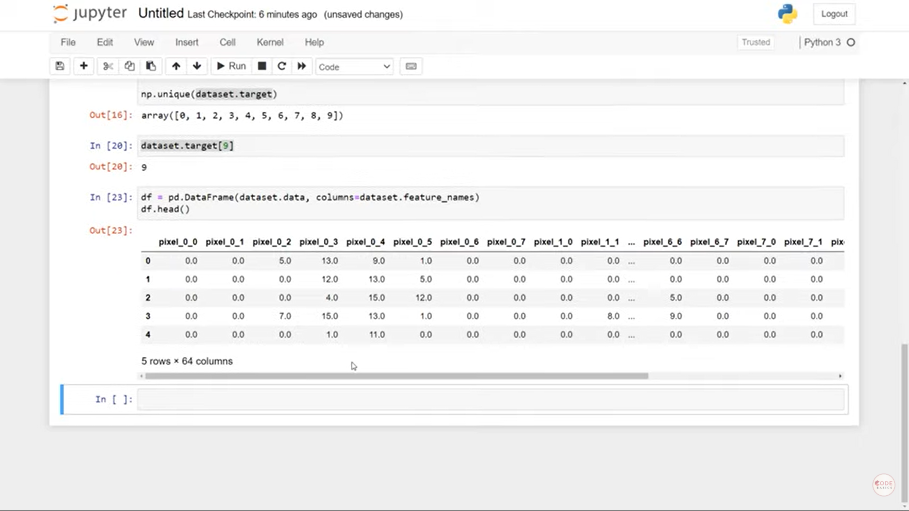

Slide 42
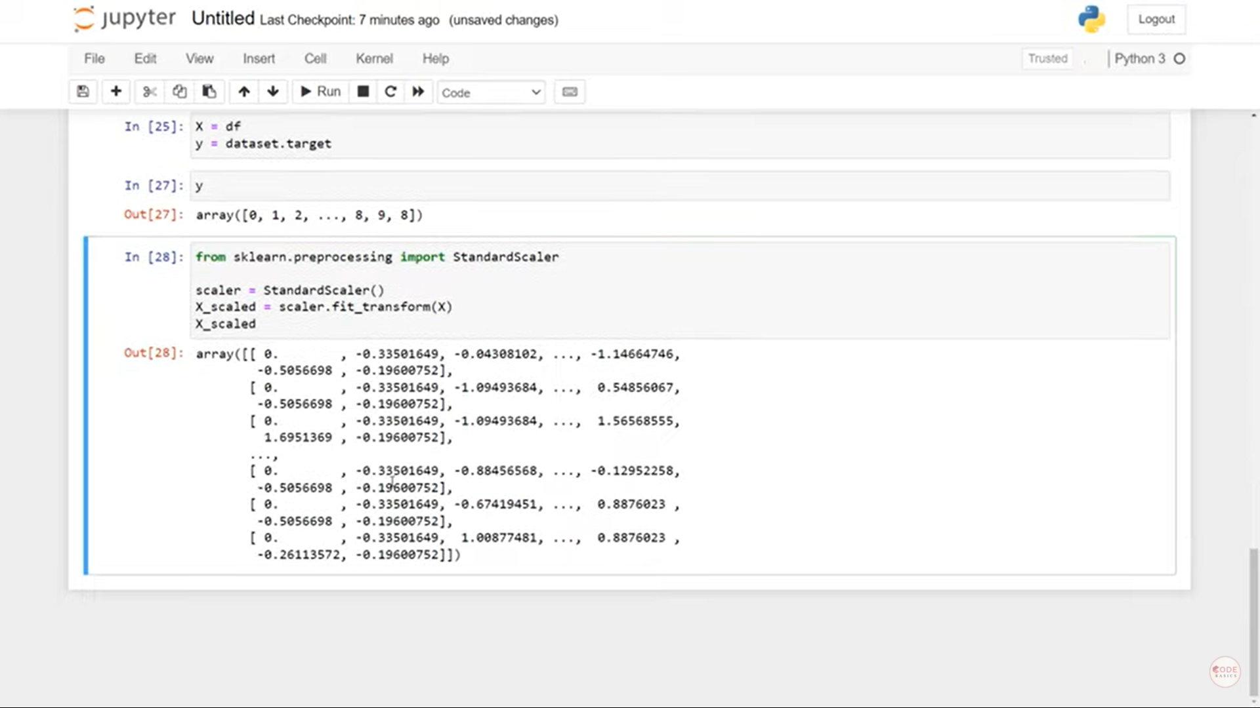

Slide 43
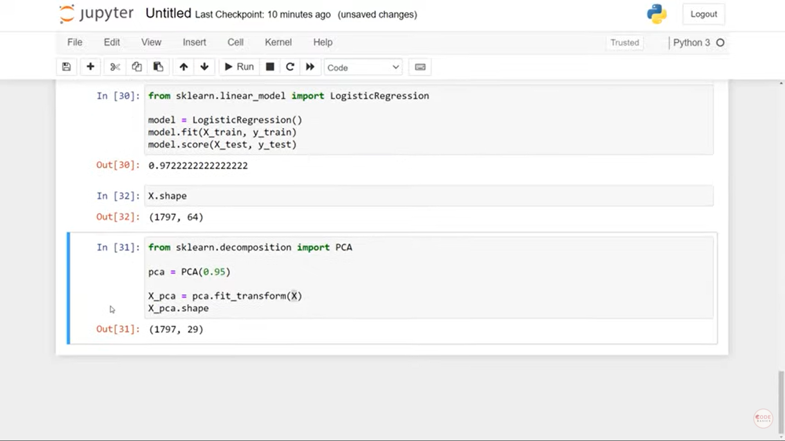

Slide 44
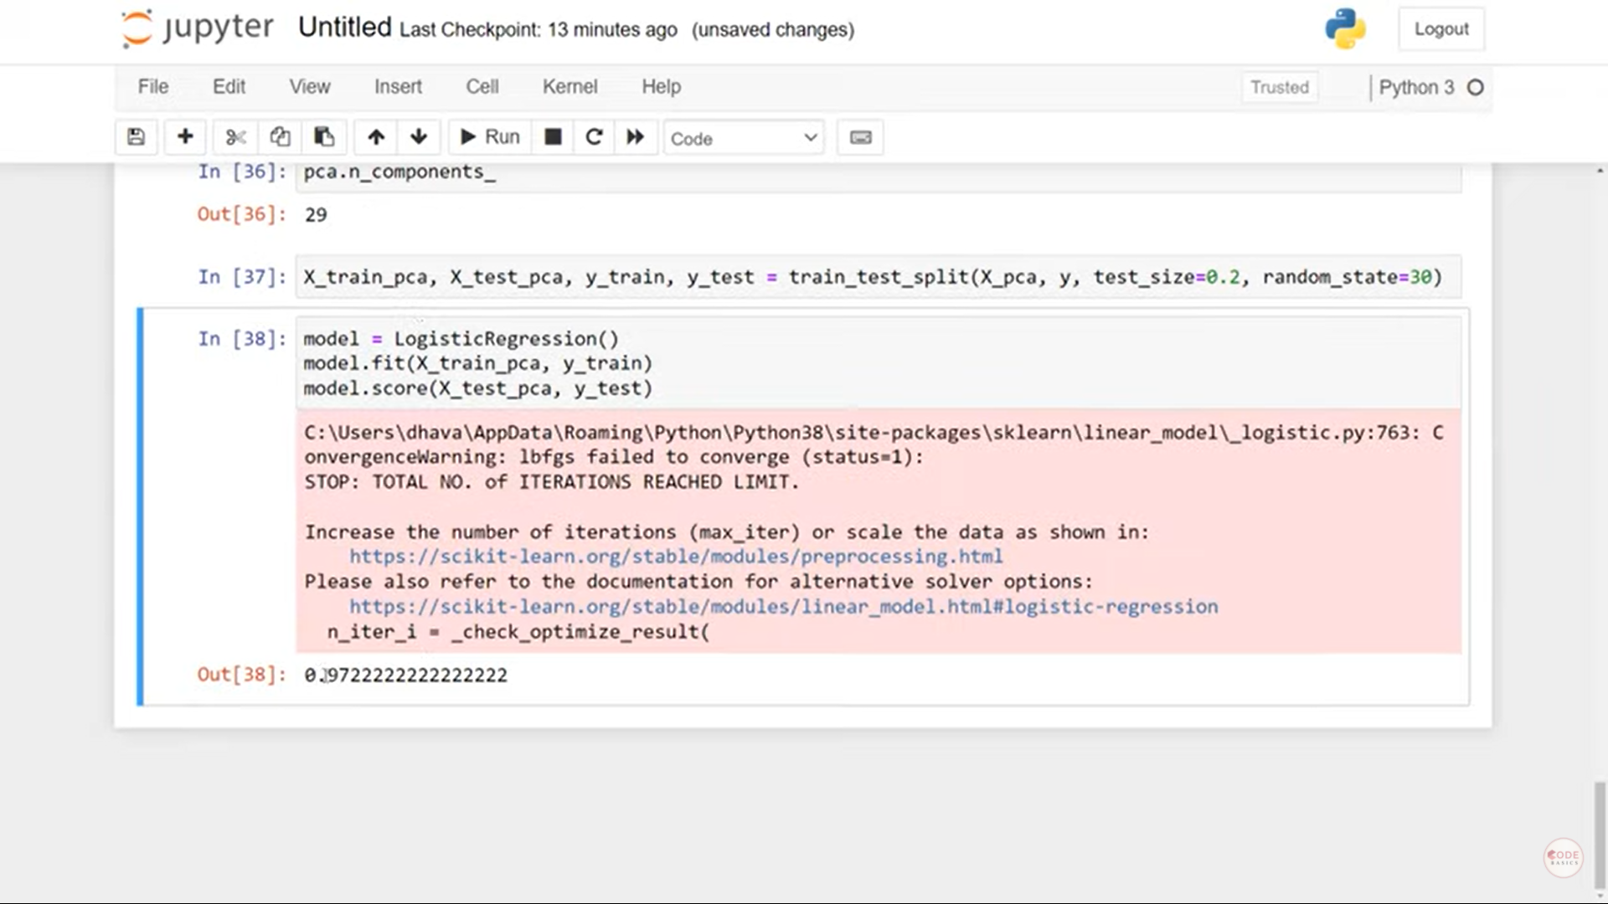

Slide 45
Thanks
Contact:
Deepak.e11296@cumail.in

